Slide 1
SIMPLEX Project Overview – TA2
From Rags to Riches:
Utilizing Richly Attributed Graphs to Reason from Heterogeneous Data
Johns Hopkins University
Joshua T. Vogelstein
Carey Priebe & Randal Burns

Slide 2
Task 3: Datafication
Overview & Timeline
 | Ingest & align multimodal data using optimized methods
Phase I | Ingest CLARITY, Light Field, Diffusion & Functional MRI
Phase II | Multimodal align for human brains, mouse brains & graphs
Phase III | Develop quality control metrics for each modality

Slide 3
Task 3 Phase I:
 | Ingest CLARITY, Light Field, Diffusion & Functional MRI
Opportunity | Such data exist, but are not stored in image databases to enable fast & arbitrary cutouts
Challenge | Require shared “dataspace” and extended data model
Action | Ingest multiple brains of each modality, and store data derivatives in extended data model
Resolution | Joint inference across multiple brains & modalities is significantly easier

Slide 4
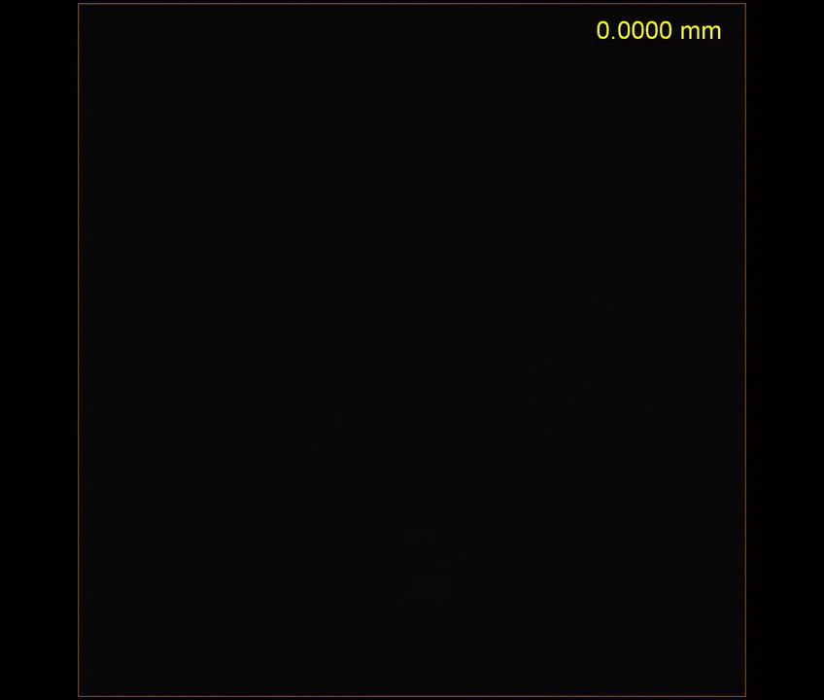
3.I.A) CLARITY
Ingested 12 CLARITY brains ~500 GB per brain
Developed isotropic downsampling for visualization purposes
Added support for ROI annotation objects
Ingested aligned atlases

Slide 5
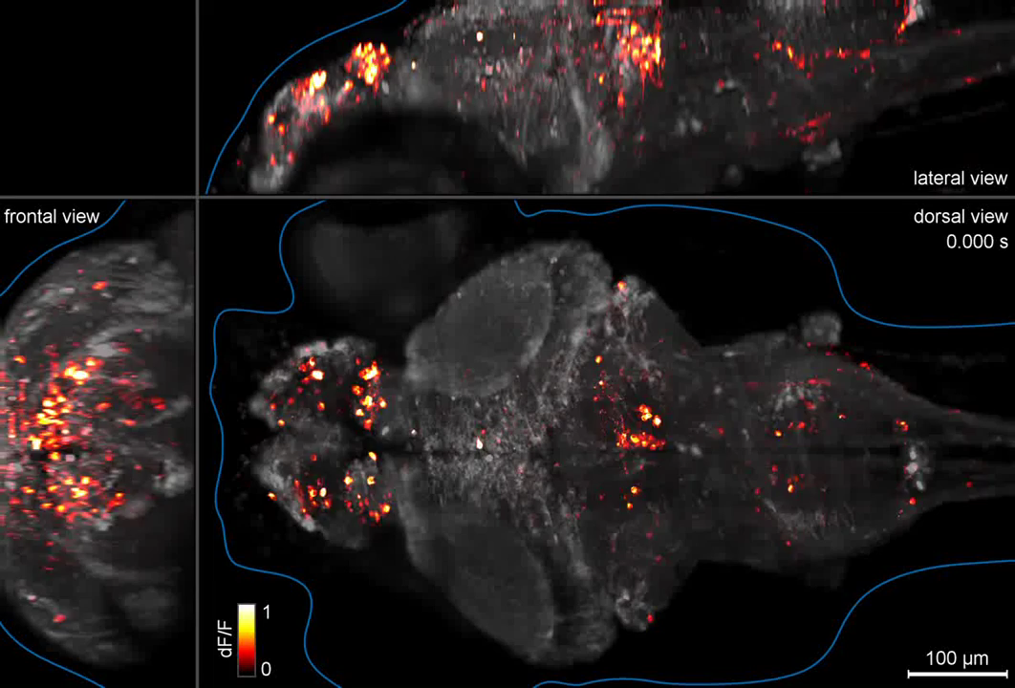
3.I.B) Calcium Imaging
Light field microscopy is 3D+time data that can be collected in same tissue as CLARITY data
We have ingested 2D+time single channel calcium imaging datasets
Will shortly ingest 3D+time and 3D+time+color datasets

Slide 6
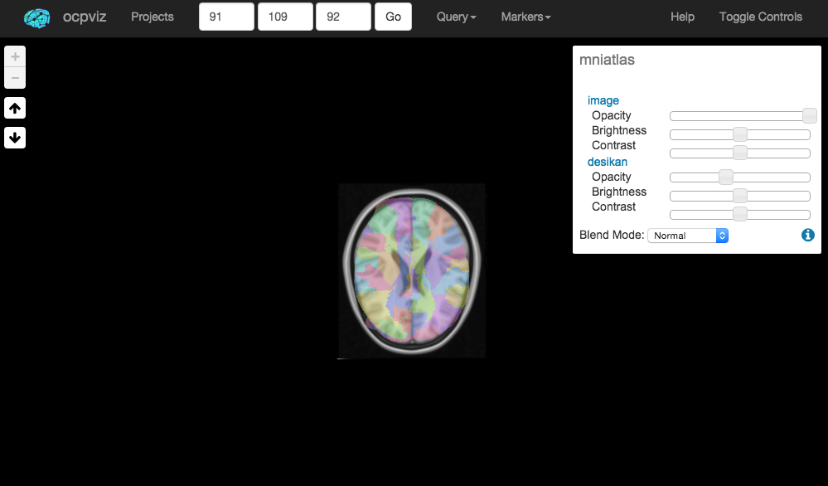
3.I.C) Diffusion MRI
Raw Diffusion MRI is 4D data (3D volume per ~100 directions
Data derivatives include “tracts” which estimate structural edges in graph
We added support for skeleton & ROI annotations
Will ingest ~2,000 dMRI datasets and derivatives

Slide 7
3.I.D) Functional MRI
Raw functional data is 3D+time
Registering fMRI to dMRI to atlas means all datasets can live on the same “dataspace”
Will ingest ~2,000 fMRI pre-processed datasets
Result will be ~2,000 multigraphs, 1 per person, ingested and co-registered & fully processed, available for everyone via a simple MATLAB or Python API

Slide 8
Task 3 Phase II:
 | Multimodal align for human brains, mouse brains & graphs
Opportunity | Multimodal brains are now ingested into spatial database, but not aligned with one another
Challenge | Images are large (~500 GB) & we desire alignment across modalities
Action | First develop multimodal alignment methods, then scale up
Resolution | Brains are now ingested in spatial database and aligned

Slide 9
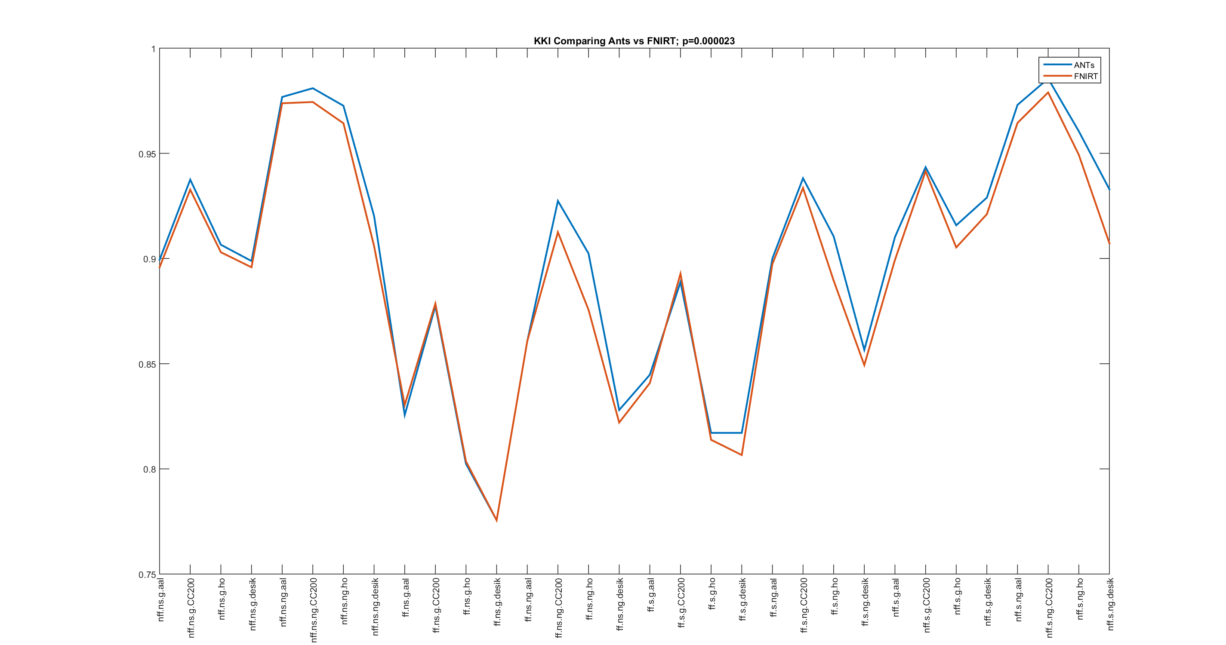
3.II.A) Multimodal Human Register
Compared two most popular registration algorithms: ANTs & FLIRT
Using optimal QC (described below), ANTs is significantly better

Slide 10
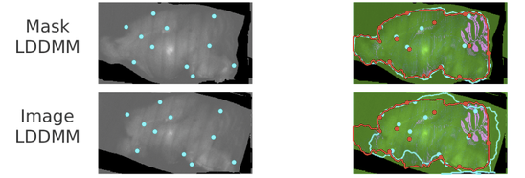
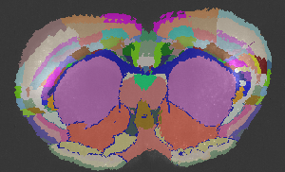
3.II.B) Mouse Multimodal Registration
Developed CLARITY to Allen Atlas deformable registration (multi-modal) using LDDMM
Open Web Services are being deployed
Similar methods can be applied to CLARITY & Calcium Imaging
Currently requires downsampling to in memory size

Slide 11
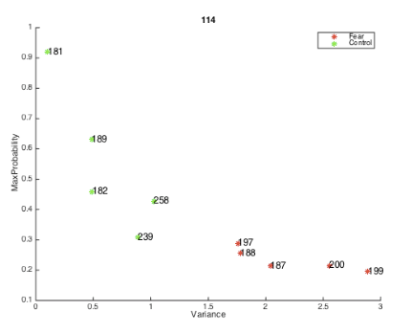
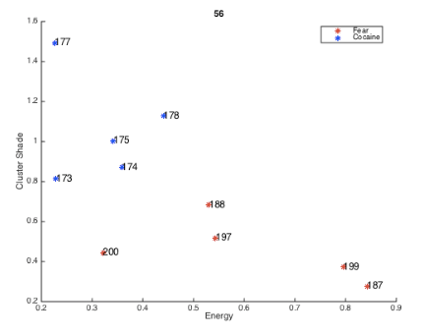
3.II.B) Mouse Multimodal Registration (cont’d)
15 CLARITY brains from 3 different experimental conditions
Using these registrations, we compute 14 texture features per ROI at coarse resolution
We find a sparse set of features that can differentiate CLARITY brains of different types
Currently working on computing features at native resolution

Slide 12
Task 4 Phase III:
 | Exploiting RAGs for classification & regression
Opportunity | We want to exploit these populations of graphs to discover biomarkers for typical & atypical phenomenology
Challenge | Theory and methods are lacking
Action | Develop theory and methods for using RAGs as predictors for classification and regression problems
Resolution | We have applied these approaches to predict creativity from human brains, and behavioral state from mice

Slide 13
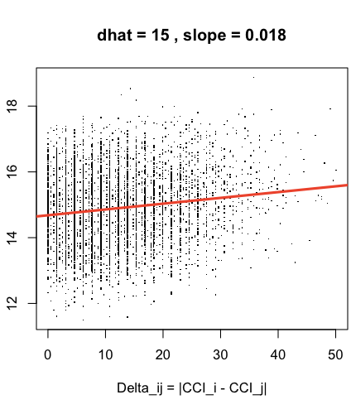
4.III.A) Nearest Neighbors
114 subjects, each with a graph and creativity score
Compute pairwise distance between creativities & also between graphs
Scatterplot to assess linear relationship between distances
P-val << 0.05, permutation test

Slide 14
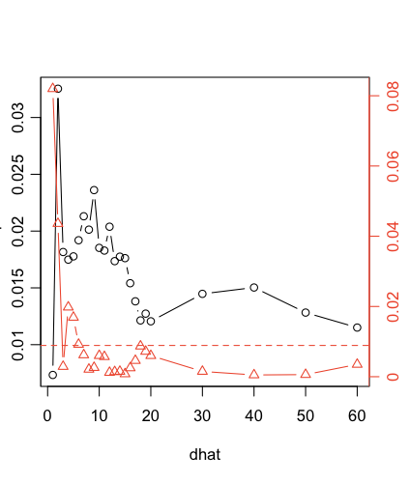
4.III.B) Network of Networks
Now jointly embed graphs
P-value is much lower
Simulations agree

Slide 15
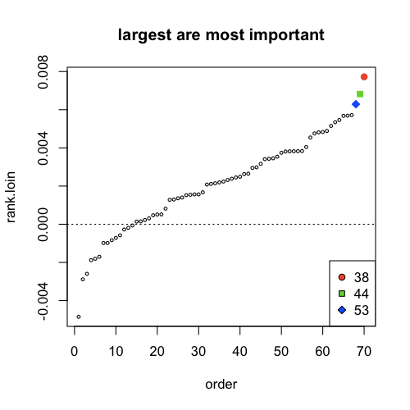
4.III.B) Network of Networks (cont’d)
Now discover which vertices are most important for confer creativity
3 vertices in Desikan atlas stand out as most important
Methods are “pre-registered”
Processing 250 new brains to discover which regions are important

Slide 16
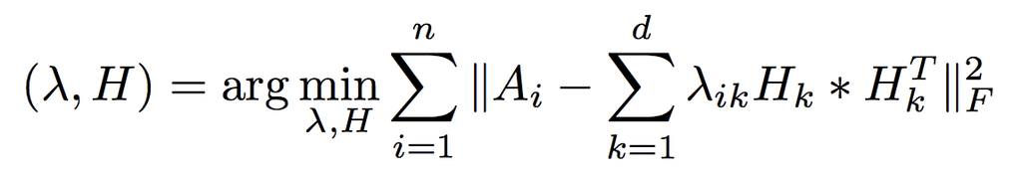
4.III.C) Tensor Factorization
Remember RAG model from TA1?
Let the eigenvalues on eigengraphs be features
Consider 2 different simple 2-class setting
Knn on eigenvalues performs as well or better than all other methods
 | Eigen Graphs | Omni | ASE | NMF
SBM | 89 | 89 | 56 | 55
RDPG | 80 | 70 | 51 | 51

Slide 17
4.III.D) Benchmarking
Network-of-networks > nearest neighbors on real data task
Tensor embedding > network-of-networks on simulated data
Tensor embedding < nearest neighbors on real data task
More analysis is required

Slide 18
Teamwork Progress
Status | Columbia | Stanford Resident
Completed | Ingested multiple datasets | Provided dataset
Completed | Provided Web-Viz capabilities
Completed | Identified initial algorithms
Y1 | FlashRAG implementation of Penalized NMF | Run Caffe Con Troll @JHU on datasets
Y1 | Benchmark | Benchmark
Y1 | Ingest remaining datasets | Deploy CCT within our pipeline

Slide 19
References
Fast Embedding for JOFC Using the Raw Stress Criterion. http://arxiv.org/abs/1502.03391
A semiparametric two-sample hypothesis testing problem for random dot product graphs. http://arxiv.org/abs/1409.2344
Community Detection and Classification in Hierarchical Stochastic Blockmodels. http://arxiv.org/absf/1503.02115
Spectral Clustering for Divide-and-Conquer Graph Matching. http://arxiv.org/abs/1310.1297
A Joint Graph Inference Case Study: the C.elegans Chemical and Electrical Connectomes. http://arxiv.org/abs/1507.08376
Covariate Assisted Spectral Clustering http://arxiv.org/abs/1411.2158

Slide 20
Software
Dense Arrays:
Image Database: http://docs.neurodata.io/open-connectome
Fast writes: http://docs.neurodata.io/neuroblaze
Fast viz: http://docs.neurodata.io/tilecache
Sparse Arrays:
Surfaces: http://docs.neurodata.io/neurosurf
API:
MATLAB: http://docs.neurodata.io/cajal/
Python: http://docs.neurodata.io/ndio/
Graphs:
FlashR: http://docs.neurodata.io/FlashR
FlashGraph: http://docs.neurodata.io/Flashgraph

Slide 21

Acknowledgements
Stats | C Priebe, Y Park, M Ketcha, D Sussman, M Tang, V Lyzinski, A Athreya, R Tang, M Tang, C Shen
Code | R Burns, D Zhang, D Mhembere, W Gray Roncal, G Kiar, E Bridgeford, A Simhal, G Sapiro, E Dyer, K Kording, M Miller, K Kutten
Data | K Deisseroth, M Milham, R Tomer, L Ye, L Grosenick, D Peterka, R Yuste
Funds | Reza & co.
Love | yummy, family, friends, universe, multiverse
Stats | C Priebe, Y Park, M Ketcha, D Sussman, M Tang, V Lyzinski
Code | R Burns, D Zhang, D Mhembere, W Gray Roncal, G Kiar, E Bridgeford, A Simhal, G Sapiro, E Dyer, K Kording
Data | J Lichtman, C Reid, S Smith, K Deisseroth, M Ahrens, M Milham
Funds | TRA (NIH), SIMPLEX, XDATA & GRAPHS (DARPA), BIGDATA & CRCNS (NIH/NSF)
Love | yummy, family, friends, earth, universe, multiverse!?

Slide 22
Questions?
http://neurodata.io
jovo@jhu.edu

